Slide 1
ML, Grass, and Wind Patterns
Francesca Mnenula
Data Science & Economics Major
St. Lawrence University ‘26
October 4, 2025

Slide 2
Project Context
Data Science major under the MCDSS department at St. Lawrence University
Week 5 of an approximately 30-week Senior Year Project for the Data Science major
Working under guidance of Dr. Ramler
Exploring the interconnectedness of data science in environmental studies
ML for Estimating Wind Patterns from Grass

Slide 3
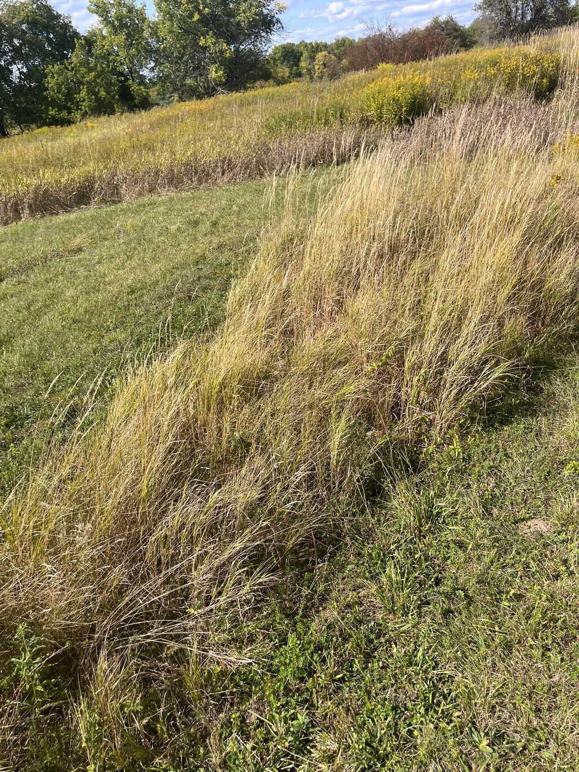
Overview
Find the connection between grass lay and wind direction
Preliminary: AI-generated and real grass images to see how ML techniques retrieve obvious/known grass-lay direction
Goal: If this works on test images, this algorithm’s methods can be extrapolated to real-world grass images in Alaska
ML for Estimating Wind Patterns from Grass

Slide 4
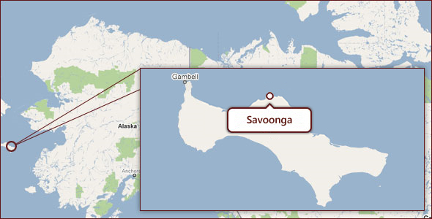
Motivation
Why does this matter?
Residents in Savoonga, Alaska have traditionally used grass orientation to interpret wind direction
Monitoring wind direction is essential for agricultural practices (precipitation, sea ice extents, hunting, etc.)
ML for Estimating Wind Patterns from Grass
Notes:
This project is motivated by the community of Savoonga, located on St. Lawrence Island in the Bering Sea. For generations, residents here have relied on the orientation of grass to interpret wind direction as part of their Traditional Ecological Knowledge. Knowing wind direction is critical, because it influences everything from precipitation and local agriculture to sea ice extent and temperatures that they use to make decisions about hunting, farming, and daily practices.

Slide 5
…from a very young age hunters are taught that if they become lost on the tundra to dig down in the snow and look for the direction the grass is laying. Traditionally the grass would be laying down to the south, southeast. But with climate change, hunters there are telling us that the prevailing wind direction has switched to the southwest, meaning the grass would be laying down to the north, northeast. - Aksik article
ML for Estimating Wind Patterns from Grass
Notes:
With these reports, we see that this change signals that the prevailing wind patterns themselves are different from what they used to be. This is a clear example of how climate change in the Arctic is not just abstract. It’s changing the reliability of traditional ecological knowledge and directly affecting how people navigate and make decisions especially in farming methods.

Slide 6

Motivation
What is the problem?
Harsh Arctic climate and wildlife in regions like Savoonga, Alaska make it difficult to keep track of changing weather patterns across time
So we need other methods, for example, looking at grass orientation
Constantly changing climate conditions make it harder to align previously known grass orientation to weather conditions
ML for Estimating Wind Patterns from Grass
Notes:
Harsh weather and wildlife in the region make it difficult for weather stations to last long enough to keep data.
So what do we do, use the TEK.
With rapidly changing climate conditions, these traditional cues are no longer as reliable. This creates a gap: the grass orientation we observe today may no longer match past wind patterns, making it harder for communities to anticipate weather and plan subsistence activities.

Slide 7
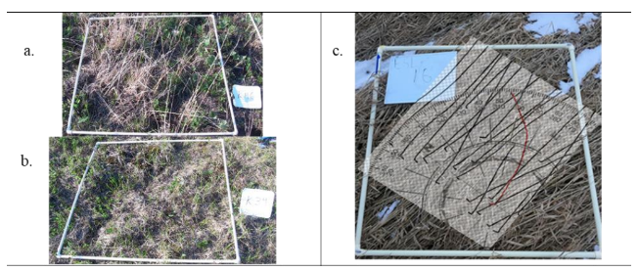
Goal
How can we use grass images taken by drones to recalibrate evolving wind direction data?
Dr. Rosales (“Environmental Studies, St Lawrence University”) and his team have taken grass images and manually measured angles of grass orientation to determine wind patterns
Can we use a Machine Learning algorithm to automate this?
ML for Estimating Wind Patterns from Grass
Notes:
Could we anticipate some human error here? Probably…

Slide 8
Stages of Research
1st Step
3rd Step
Can we measure grass orientation from images?
Yes! – HOG Algorithm (Sunshine, 2024).
How well can we replicate findings using the algorithm with images from Canton before Alaska?
2nd Step
4th Step
How well can the components of HOG recover direction of grass leaning under controlled scenarios?
How might this support communities monitoring wind?
ML for Estimating Wind Patterns from Grass
Notes:
Steps 2 and 3 is where my project is and the next steps are.

Slide 9
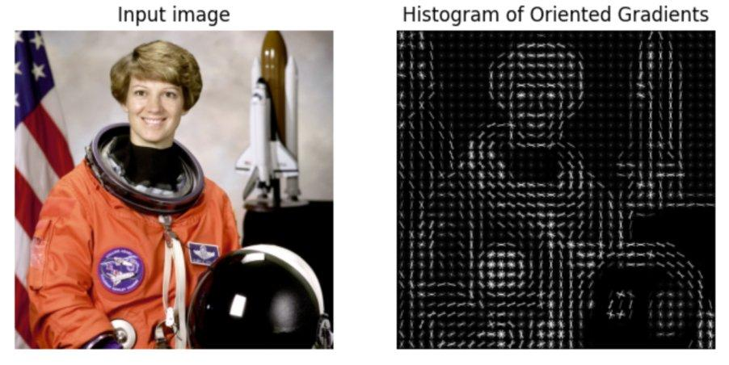
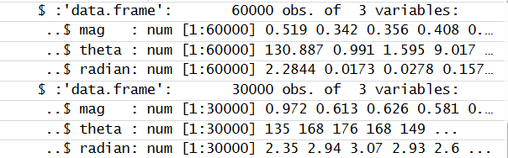
How does the HOG Algorithm work?
ML for Estimating Wind Patterns from Grass
Notes:
Histogram of Oriented Gradients, or HOG, is a method used to capture the orientation of textures in an image. First, the image is split into small patches called cells, and we compute the gradient magnitude and direction in each. These local gradients, magnitudes, and angles are extracted and then aggregated into a vectors that describe the overall image to represent it into patterns that identify images like is shown here. Thus, in the real world, HOG is often used for pedestrian detection in self-driving cars, where it helps identify people based on the shapes and edges in the image. For this project, we’re focusing merely extracting the data of magnitudes, angles, and directions to estimate grass orientation.

Slide 10
Why do gradients work for grass images?
The HOG algorithm is often used for object detection techniques such as pedestrian/vehicle detection
Gradient extraction techniques identify dominant directions and magnitudes because grass images have defined fine and linear textures
We are interested in capturing that general trend/flow in the grass
Notes:
Because the HOG algorithm simplifies the image to just the flow and overall patterns in local regions of the image, it makes it very useful to detect objects.
Because this process extracts data on directions, magnitudes and angles, we can identify dominant directions in grass images especially because grass images have defined fine and linear textures.

Slide 11
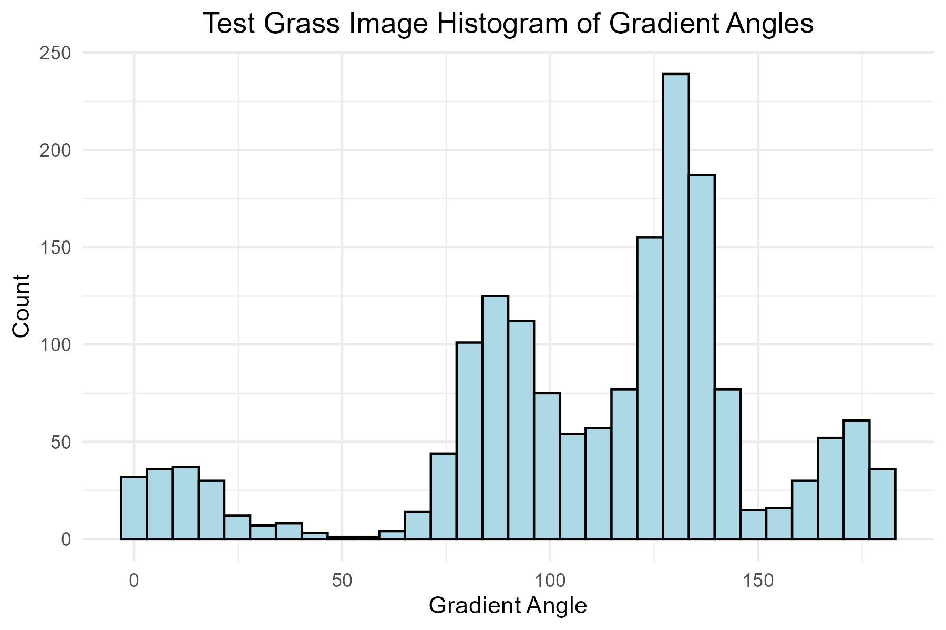
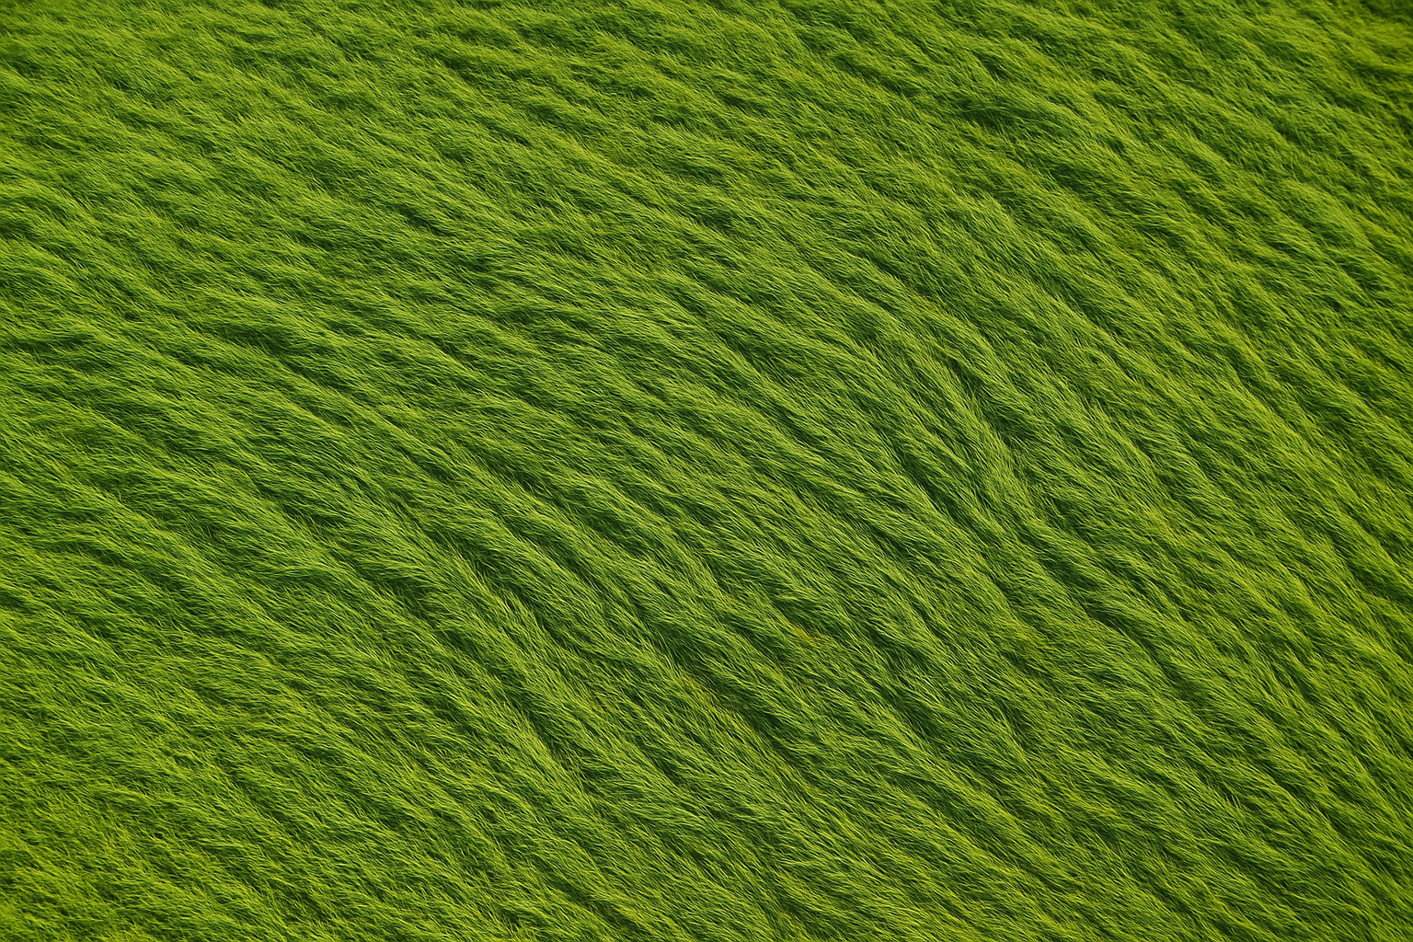
Sample A
ChatGPT Generated Image:
"Create an overhead (drone style) image of a grassy field where the wind has blown it down in a specific direction (135 degrees clockwise from north)"
Predominant angles and directions match direction fed into the prompt
Notes:
Put arrows to show the predominant direction goes along with angles that chatgpt was told to do. Add the other image that we can tell that we are able to detect edges. Dr Rosales will take photos later eventually that we will use. Bridge to where its going with image of wind vane.
The polar plot – HOG looks at top left moving forward moving top corner down bottom corner – could be either really and needs human discretion to see the actual tips of grass.

Slide 12
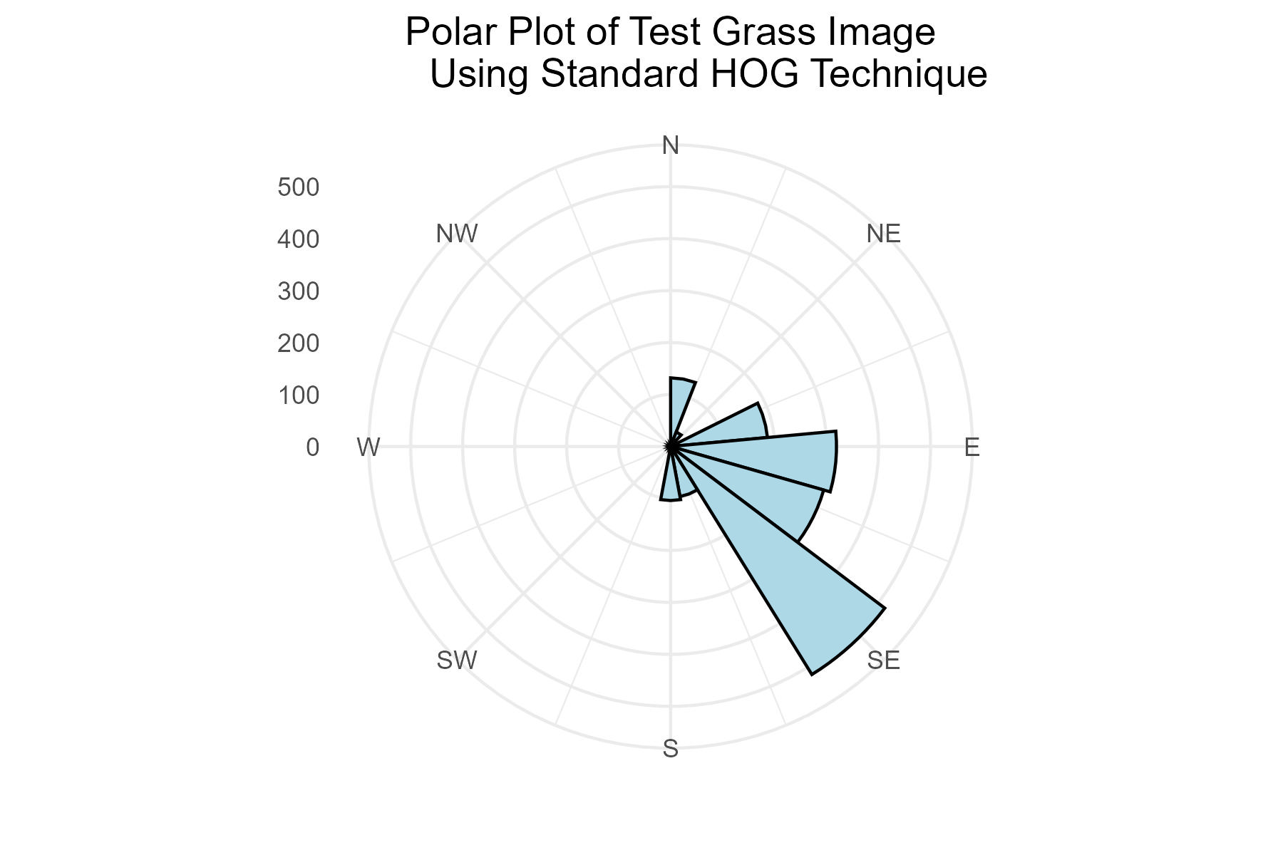
Sample A
ChatGPT Generated Image:
"Create an overhead (drone style) image of a grassy field where the wind has blown it down in a specific direction (135 degrees clockwise from north)"
Notes:
Put arrows to show the predominant direction goes along with angles that chatgpt was told to do. Add the other image that we can tell that we are able to detect edges. Dr Rosales will take photos later eventually that we will use. Bridge to where its going with image of wind vane.
The polar plot – HOG looks at top left moving forward moving top corner down bottom corner – could be either really and needs human discretion to see the actual tips of grass.

Slide 13
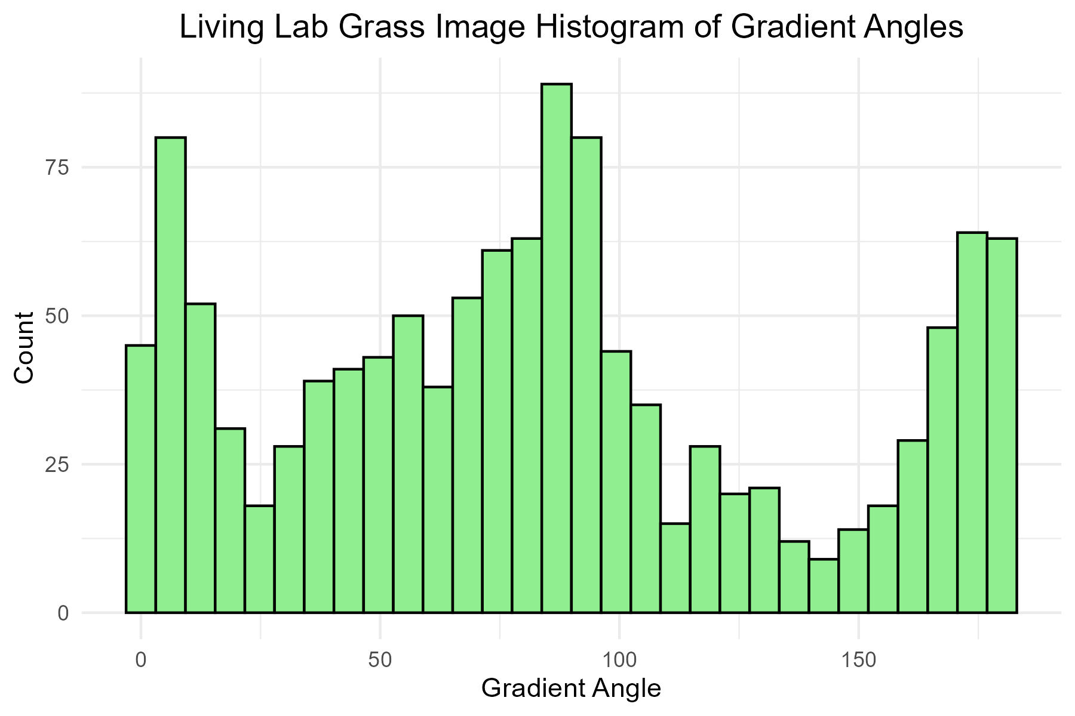
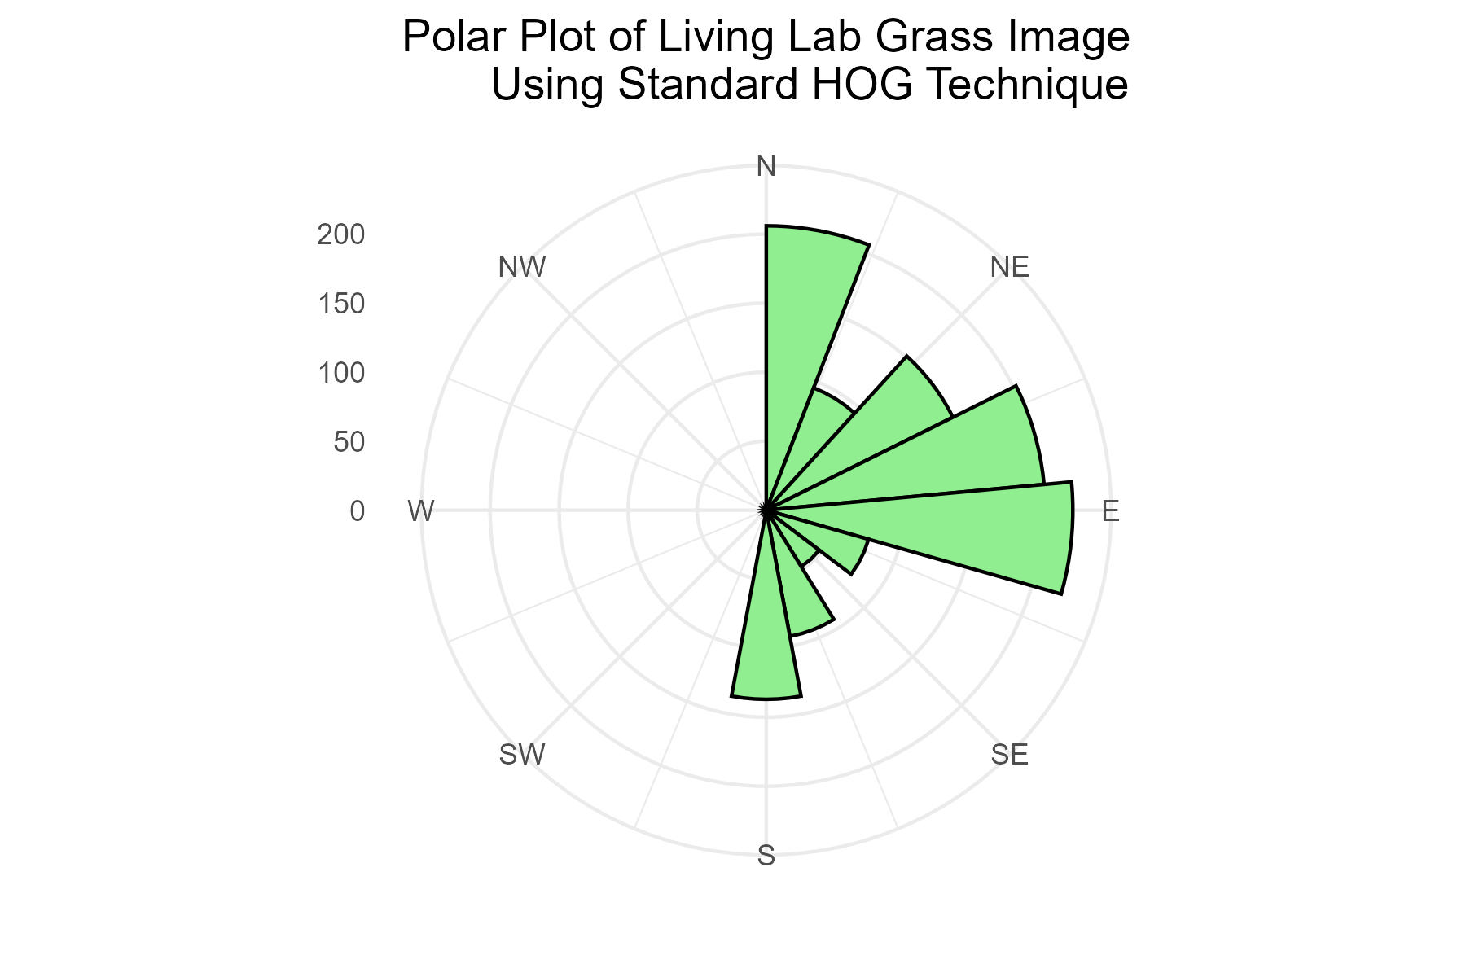
Sample B
Living Lab Image:
Histogram and Polar Plots:
An image taken from the St. Lawrence Living Lab to illustrate ability to retrieve gradient angles from real images.
Notes:
SLU living lab close to the golf course that is part of campus as an outdoor space that environmanetal studies majors.
This represents a more complex case though this is not the type of images we would be
Put arrows to show the predominant direction goes along with angles that chatgpt was told to do. Add the other image that we can tell that we are able to detect edges. Dr Rosales will take photos later eventually that we will use. Bridge to where its going with image of wind vane.
Different components of dominant directions that makes it complex. This is what we’re gonna be going into. How do we decide predominant direction from images with

Slide 14
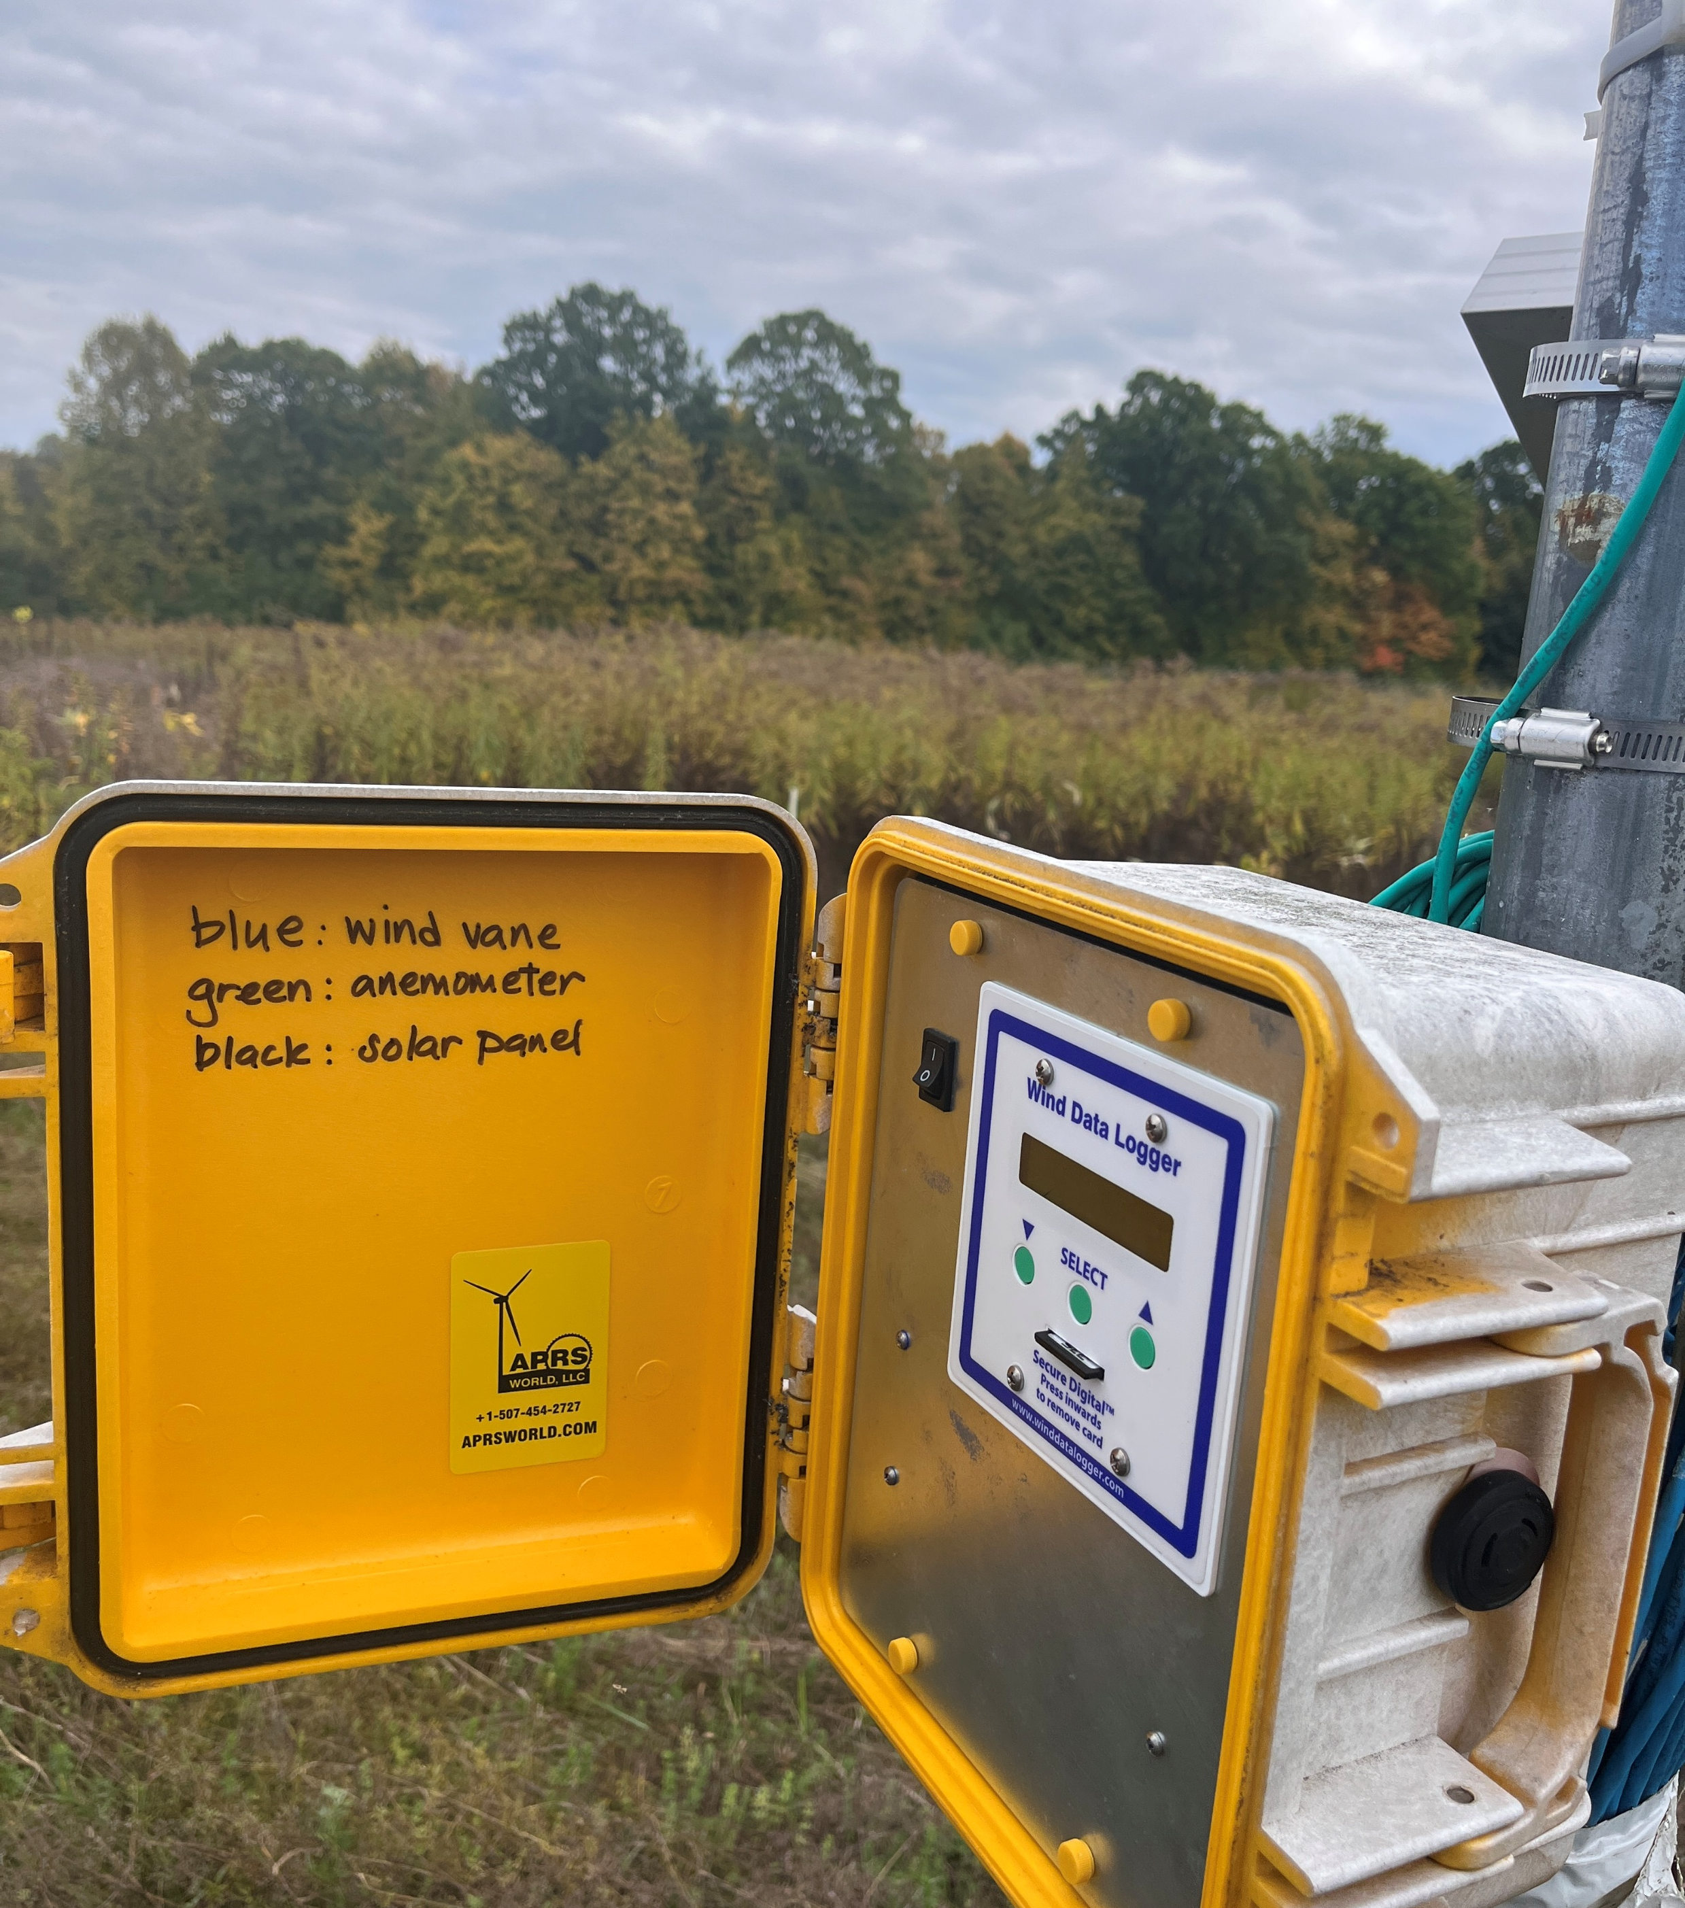
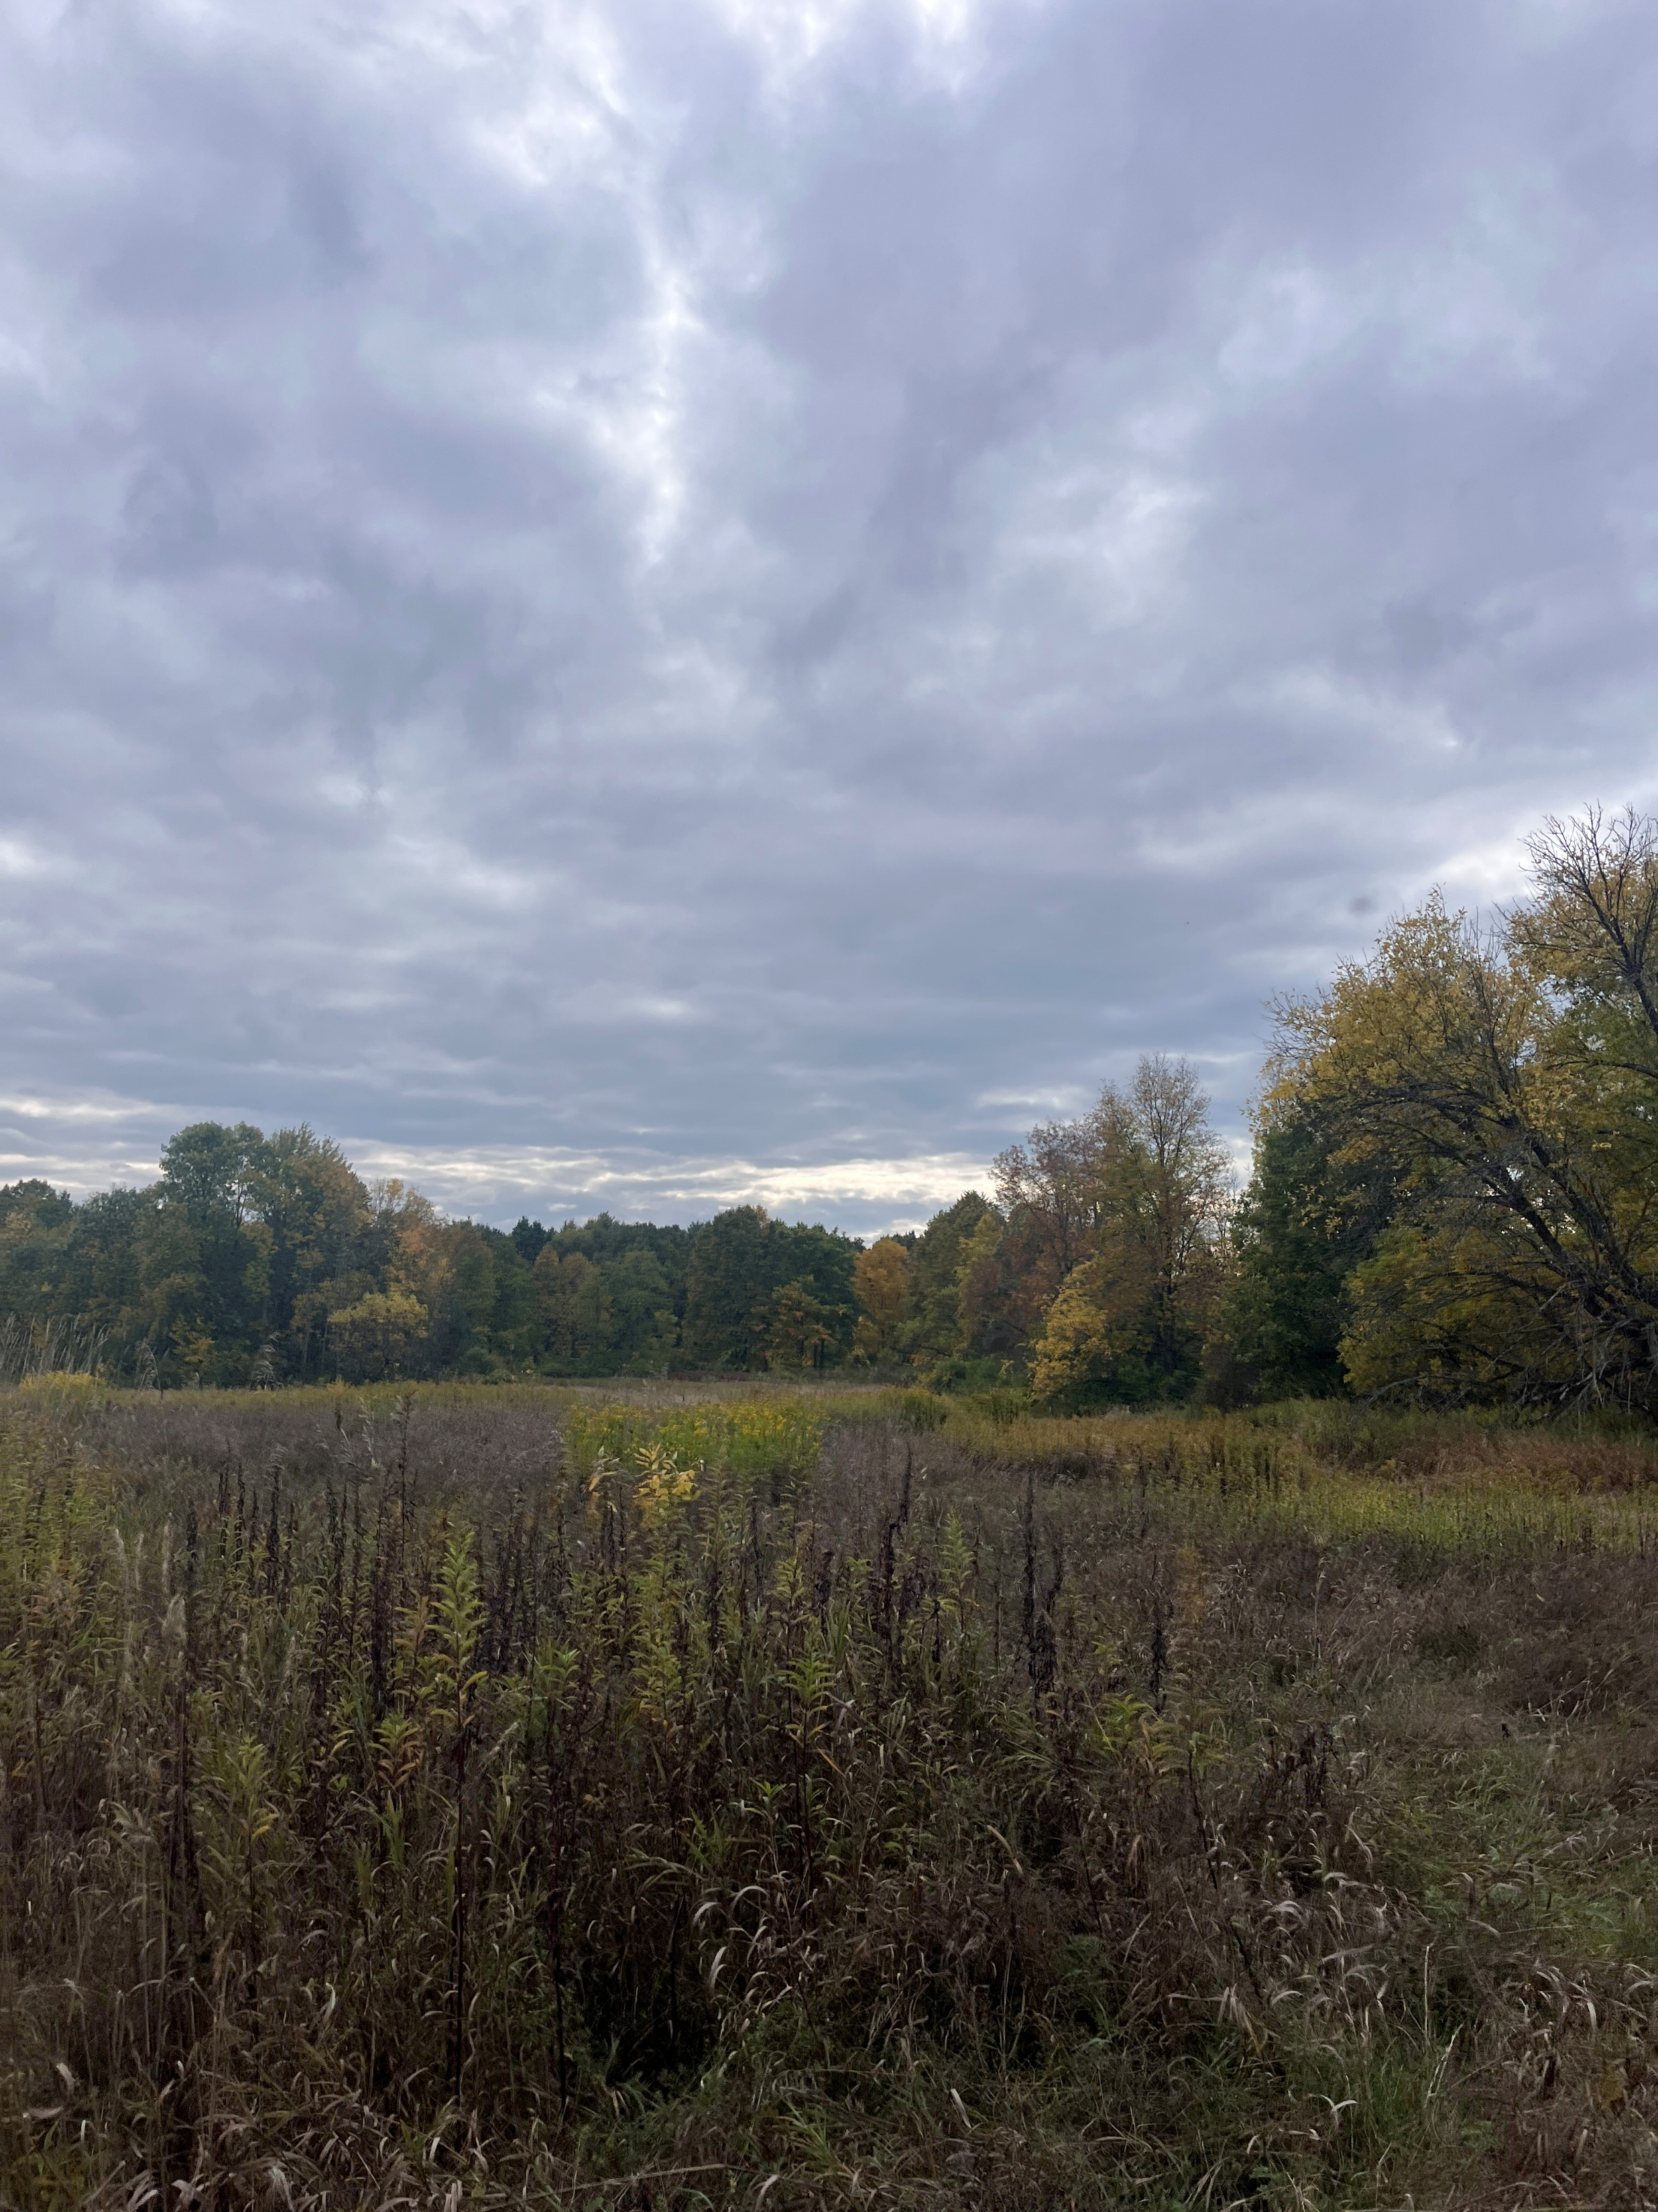
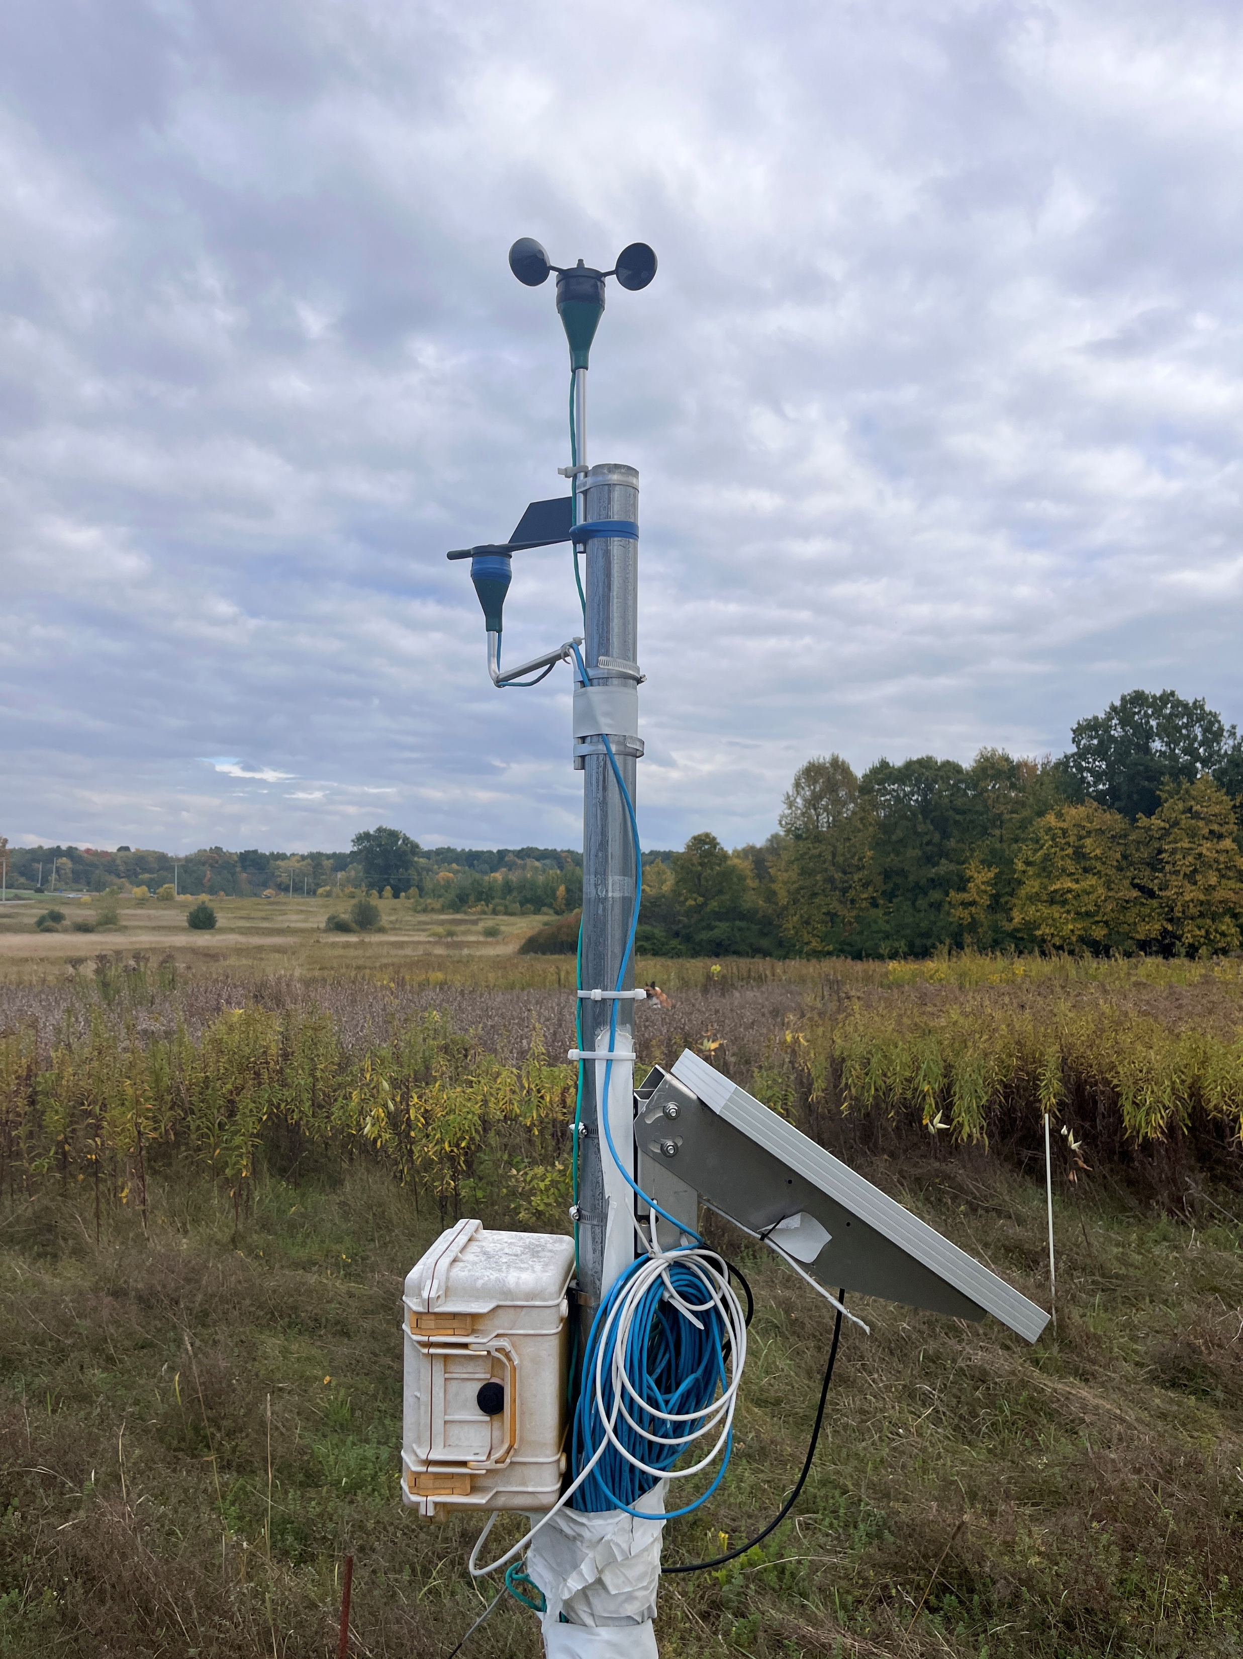
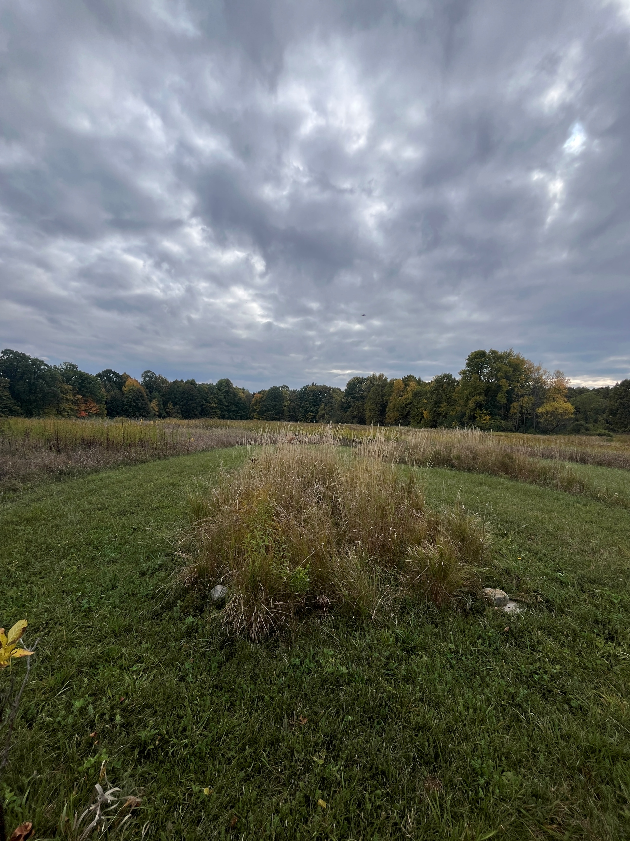
Real Weather Data
The SLU Living Lab has tundra plants like those grown in the Savoonga region
There is a wind station right next to the tundra plants to compare the wind data to grass data

Slide 15
Next Steps
Run full simulation with multiple varying test cases
Get aerial photos from Living Lab when grass falls this month
Apply to real-world images from the Savoonga region
Notes:
Might use Fourier – both and compare later on

Slide 16
Thank you
Additional Credits to:
Dr. Ramler, Ben Sunshine, Dr. Rosales
Francesca Mnenula
fmnen22@stlawu.edu

